Slide 1
TREAT STUDY AND GAC DISPOSITION
Briefing for the Buckman Direct Diversion Board June 7, 2018
James P. Bearzi
Senior Environmental Geologist
Glorieta Geoscience, Inc.
Santa Fe, New Mexico

Slide 2
What Are The Main Issues?
TREAT = The Removal Efficiency & Assessment of Treatments
For both TREAT and Granulated Activated Carbon (GAC)
Quality Assurance/Quality Control (QA/QC)
Sampling and Analysis
What do the data tell us now? What are the implications? Potential sources?
What do we do next?

Slide 3
Expert Panel
Expert Panel
James P. Bearzi, Glorieta Geoscience, Inc. (Lead)
Bill Schneider, City of Santa Fe
Alex Puglisi, City of Santa Fe
Daniela Bowman, BDD
Jerry Schoeppner, Santa Fe County
Kerry Howe, UNM
Work overseen by Rick Carpenter and Charles Vokes

Slide 4
What Do the TREAT Results Tell Us?
Safe water has been and continues to be delivered to customers
Important questions raised about chemicals detected by the analytical laboratories
Are the results “real?”
What are potential sources?
What sampling should be done to confirm previous results?
What sampling should be done on a routine basis going forward?

Slide 5
TREAT Study Data
QC complete; some errors found and corrected
QA depends on objectives of study
TREAT study showed BDD finished water is below MCLs, but had measurable (but necessarily quantifiable) concentrations of some chemicals
Sampling issues and procedures
Analysis challenges (including changing analytical laboratories between TREAT studies 1-2 and 3-4)

Slide 6
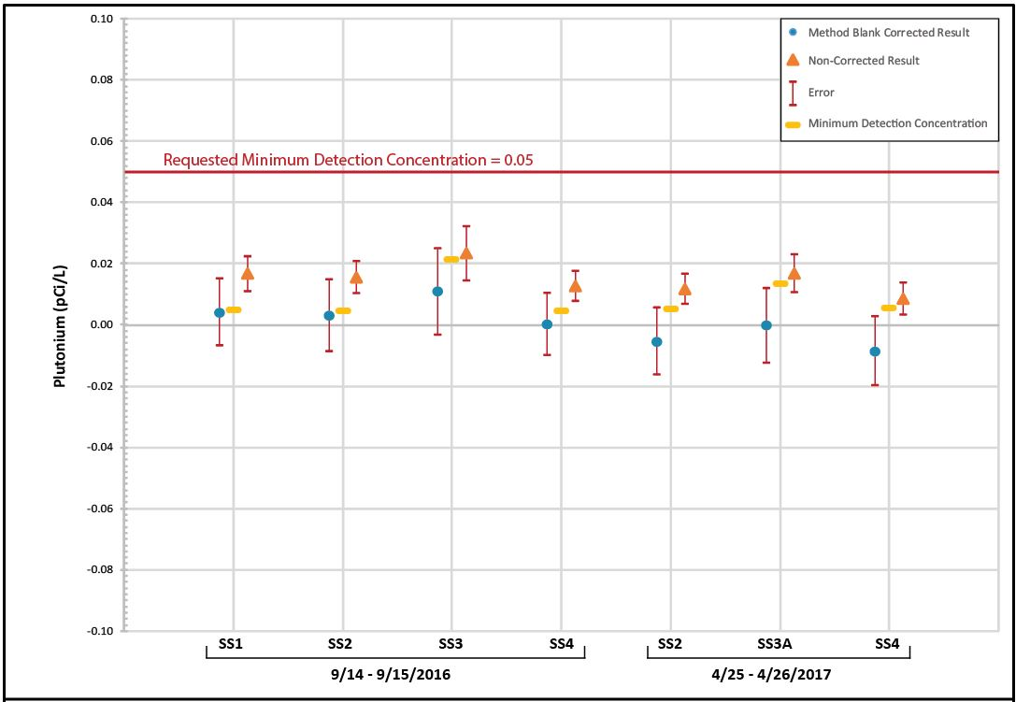
TREAT Study Data (Plutonium Illustration)
Gross Alpha MCL = 15 pCi/l
Appropriately balance data quality and detection limits.
Resample with rigorous QA procedures in place.

Slide 7
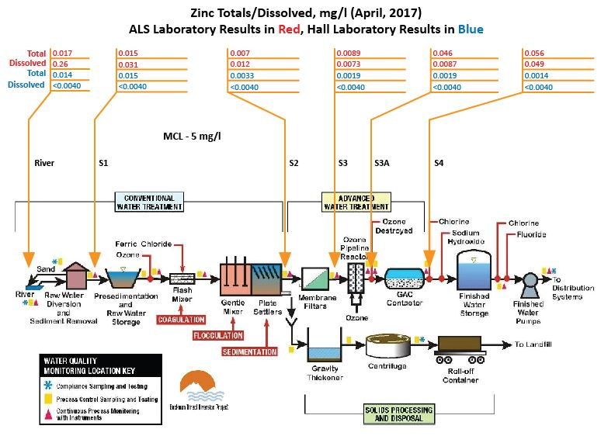
TREAT Study Data (Zinc Illustration)
Dissolved > Totals (in some cases)
Concentrations may increase with travel through the treatment works (in some cases)
Laboratory selection crucial

Slide 8
Potential Sources
Radionuclides
Raw Water (Rio Grande; LANL)
Background
Return flows within Plant
Laboratory or sampling error
Metals (trends)
Normal Plant operation (including return flows)
Total flow rate through process units
pH changes
Treatment products
Laboratory or sampling error
Pharmaceuticals and other organics
Upriver point and non-point sources
Laboratory or sampling error

Slide 9
GAC and Source
Evaluate GAC data – same issues as TREAT
Are chemicals found in TREAT in new GAC?
Are they being concentrated in GAC? Or desorbed?
GAC age/removal efficiencies for organics and metals
Is additional or revised sampling required?
What are potential contaminant sources?
What are appropriate disposal pathways?
What are the potential regulatory issues?

Slide 10
What Do We Do Next?
TREAT 5 Preparation (Fall 2018)
Need for robust study design and implementation
CM – Conceptual Model
DQOs – Data Quality Objectives
QAPP – Quality Assurance Project Plan
SAP – Sampling and Analysis Plan
QA/QC – Quality Assurance/Quality Control
Utilize existing data the Plant has (pH, turbidity, time) and assess possible correlations with TREAT results
Resolve GAC issues

Slide 11
Take Home Message
Safe water continues to be delivered to customers
Need for TREAT 5 with robust study design
Study is reproducible with clear data quality objectives
Confirms or refutes preliminary results (TREATs 1-4)
Analytical laboratory selection
Assess disposition of GAC
Expert Panel provides technical support to BDD management and staff

